Slide 1
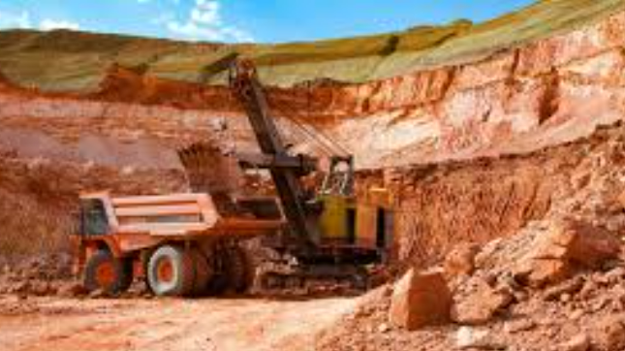
AusMine Resources SQL Views
Michael Le

Slide 2
Requirements
Install and Download SQL Server Express (2022,or 2025 (much preferred)) from Microsoft
Files and sources from my repository:
Main-Stuff/DA Bootcamp 2026 Emergi Mentors/Week 2 SQL Mastery/Module 4 Advanced SQL and Enterprise Analytics/AusMine_Resources_Mining_Operations_Analytics at main · Mikele02171/Main-Stuff

Slide 3

Content
Create database for AusMine Resources
DDL: Create tables for sites, employees
DDL: Create tables for equipment, production
DDL: Create safety incidents, Operations costs
DDL: Create indexes for performance
DML: Inserting values into sites, Employees, Equipment, Production, Safety Incidents, Operations costs
DQL: Validation Check
DQL: Site Performance
DQL: View for Active Sites
DQL: Security View, hiding salary data
DQL: Complex View for SitePerformanceDashboard
DQL: Parameterized Queries on Views on Production Analysis
DQL: Updating Data through views on Site Managers
DQL: Managing views on Active Sites
DQL: Data Quality Views and Validation
DQL: Indexed Views for Performance
DQL: Simple View for Operational Equipment
DQL: Create Security View for CostSummary
DQL: Create Analytical Weekly Production Trends View
DQL: Create Dashboard for Executive Dashboard

Slide 4
Create database for AusMine Resources
USE master;
GO
-- Drop database if exists (training reset)
IF DB_ID('AusMine_Resources') IS NOT NULL
BEGIN
ALTER DATABASE AusMine_Resources SET SINGLE_USER WITH ROLLBACK IMMEDIATE;
DROP DATABASE AusMine_Resources;
END
GO
-- Create fresh database
CREATE DATABASE AusMine_Resources;
GO
USE AusMine_Resources;
GO
PRINT '✓ Database AusMine_Resources created successfully';
PRINT '';
GO

Slide 5
DDL: Create tables for sites, employees
PRINT '--- Creating AusMine Resources Database Schema ---';
PRINT '';
-- Sites table (Mining locations)
CREATE TABLE sites (
site_id INT PRIMARY KEY IDENTITY(1,1),
site_code NVARCHAR(20) NOT NULL UNIQUE,
site_name NVARCHAR(100) NOT NULL,
state NVARCHAR(3) NOT NULL,
resource_type NVARCHAR(50) NOT NULL,
opened_date DATE NOT NULL,
status NVARCHAR(20) NOT NULL DEFAULT 'Active',
site_manager NVARCHAR(100),
CONSTRAINT CK_state CHECK (state IN ('WA', 'QLD', 'NT', 'SA', 'NSW')),
CONSTRAINT CK_resource CHECK (resource_type IN ('Iron Ore', 'Gold', 'Coal', 'Copper', 'Lithium')),
CONSTRAINT CK_status CHECK (status IN ('Active', 'Maintenance', 'Closed'))
);

Slide 6
-- Employees table
CREATE TABLE employees (
employee_id INT PRIMARY KEY IDENTITY(1,1),
employee_code NVARCHAR(20) NOT NULL UNIQUE,
first_name NVARCHAR(50) NOT NULL,
last_name NVARCHAR(50) NOT NULL,
email NVARCHAR(100) NOT NULL,
job_title NVARCHAR(100) NOT NULL,
department NVARCHAR(50) NOT NULL,
site_id INT,
hire_date DATE NOT NULL,
annual_salary DECIMAL(12,2) NOT NULL, -- SENSITIVE DATA
superannuation DECIMAL(12,2) NOT NULL, -- SENSITIVE DATA
employment_status NVARCHAR(20) NOT NULL DEFAULT 'Active',
CONSTRAINT FK_employees_sites FOREIGN KEY (site_id) REFERENCES sites(site_id),
CONSTRAINT CK_employment_status CHECK (employment_status IN ('Active', 'On Leave', 'Terminated'))
);

Slide 7
DDL: Create tables for equipment, production
-- Equipment table
CREATE TABLE equipment (
equipment_id INT PRIMARY KEY IDENTITY(1,1),
equipment_code NVARCHAR(30) NOT NULL UNIQUE,
equipment_type NVARCHAR(50) NOT NULL,
manufacturer NVARCHAR(100) NOT NULL,
model NVARCHAR(100) NOT NULL,
site_id INT NOT NULL,
purchase_date DATE NOT NULL,
purchase_cost DECIMAL(15,2) NOT NULL, -- SENSITIVE DATA
operational_status NVARCHAR(20) NOT NULL DEFAULT 'Operational',
last_maintenance_date DATE,
CONSTRAINT FK_equipment_sites FOREIGN KEY (site_id) REFERENCES sites(site_id),
CONSTRAINT CK_operational_status CHECK (operational_status IN ('Operational', 'Maintenance', 'Decommissioned'))
);

Slide 8
-- Production table (Daily production records)
CREATE TABLE production (
production_id INT PRIMARY KEY IDENTITY(1,1),
site_id INT NOT NULL,
production_date DATE NOT NULL,
resource_type NVARCHAR(50) NOT NULL,
tonnes_produced DECIMAL(15,2) NOT NULL,
grade_percentage DECIMAL(5,2), -- Quality metric (e.g., iron content %)
shift_type NVARCHAR(20) NOT NULL,
operating_hours DECIMAL(5,2) NOT NULL,
CONSTRAINT FK_production_sites FOREIGN KEY (site_id) REFERENCES sites(site_id),
CONSTRAINT CK_shift_type CHECK (shift_type IN ('Day', 'Night', 'Both'))
);

Slide 9
DDL: Create safety incidents, Operations costs
-- Safety incidents table
CREATE TABLE safety_incidents (
incident_id INT PRIMARY KEY IDENTITY(1,1),
site_id INT NOT NULL,
incident_date DATE NOT NULL,
incident_type NVARCHAR(50) NOT NULL,
severity NVARCHAR(20) NOT NULL,
description NVARCHAR(500),
resolved BIT NOT NULL DEFAULT 0,
CONSTRAINT FK_incidents_sites FOREIGN KEY (site_id) REFERENCES sites(site_id),
CONSTRAINT CK_severity CHECK (severity IN ('Minor', 'Moderate', 'Serious', 'Critical'))
);

Slide 10
-- Costs table (Operating costs)
CREATE TABLE operating_costs (
cost_id INT PRIMARY KEY IDENTITY(1,1),
site_id INT NOT NULL,
cost_date DATE NOT NULL,
cost_category NVARCHAR(50) NOT NULL,
amount DECIMAL(15,2) NOT NULL, -- SENSITIVE DATA
description NVARCHAR(200),
CONSTRAINT FK_costs_sites FOREIGN KEY (site_id) REFERENCES sites(site_id),
CONSTRAINT CK_cost_category CHECK (cost_category IN ('Labour', 'Equipment', 'Energy', 'Materials', 'Maintenance', 'Other'))
);

Slide 11
DDL: Create indexes for performance
-- Create indexes for performance
CREATE INDEX IX_production_site_date ON production(site_id, production_date);
CREATE INDEX IX_employees_site ON employees(site_id);
CREATE INDEX IX_equipment_site ON equipment(site_id);
CREATE INDEX IX_costs_site_date ON operating_costs(site_id, cost_date);
CREATE INDEX IX_incidents_site_date ON safety_incidents(site_id, incident_date);
PRINT '✓ Base tables created with indexes';
PRINT '';
GO

Slide 12
DML: Inserting values into sites, Employees, Equipment, Production, Safety Incidents, Operations costs
-- Insert mining sites
INSERT INTO sites (site_code, site_name, state, resource_type, opened_date, status, site_manager)
VALUES
('WA-IRON-01', 'Pilbara Iron Mine', 'WA', 'Iron Ore', '2015-03-15', 'Active', 'Sarah Mitchell'),
('WA-GOLD-01', 'Kalgoorlie Gold Mine', 'WA', 'Gold', '2012-07-20', 'Active', 'James Anderson'),
('QLD-COAL-01', 'Bowen Basin Coal Mine', 'QLD', 'Coal', '2010-05-10', 'Active', 'David Chen'),
('NT-GOLD-01', 'Tanami Gold Mine', 'NT', 'Gold', '2018-11-01', 'Active', 'Emma Thompson'),
('WA-LITH-01', 'Greenbushes Lithium Mine', 'WA', 'Lithium', '2020-02-15', 'Active', 'Michael O''Brien'),
('QLD-COPR-01', 'Mount Isa Copper Mine', 'QLD', 'Copper', '2008-09-22', 'Active', 'Lisa Wong'),
('WA-IRON-02', 'Port Hedland Iron Mine', 'WA', 'Iron Ore', '2014-06-30', 'Active', 'Robert Taylor'),
('SA-COPR-01', 'Olympic Dam Copper Mine', 'SA', 'Copper', '2005-12-01', 'Maintenance', 'Jennifer Lee');
PRINT '✓ Inserted 8 mining sites';
PRINT '';
GO

Slide 13
-- Insert employees (120 employees across sites)
DECLARE @SiteID INT = 1;
DECLARE @EmpCount INT = 0;
WHILE @SiteID <= 8
BEGIN
-- Site Manager
INSERT INTO employees (employee_code, first_name, last_name, email, job_title, department, site_id, hire_date, annual_salary, superannuation, employment_status)
VALUES
('EMP-' + RIGHT('0000' + CAST(@SiteID * 100 AS NVARCHAR), 4), 'Site', 'Manager', 'manager@ausmine.com.au', 'Site Manager', 'Management', @SiteID, '2020-01-15', 185000.00, 17575.00, 'Active');
-- Engineers (3 per site)
INSERT INTO employees (employee_code, first_name, last_name, email, job_title, department, site_id, hire_date, annual_salary, superannuation, employment_status)
VALUES
('EMP-' + RIGHT('0000' + CAST(@SiteID * 100 + 1 AS NVARCHAR), 4), 'Mining', 'Engineer1', 'engineer1@ausmine.com.au', 'Mining Engineer', 'Engineering', @SiteID, '2020-03-01', 125000.00, 11875.00, 'Active'),
('EMP-' + RIGHT('0000' + CAST(@SiteID * 100 + 2 AS NVARCHAR), 4), 'Mining', 'Engineer2', 'engineer2@ausmine.com.au', 'Mining Engineer', 'Engineering', @SiteID, '2020-06-15', 125000.00, 11875.00, 'Active'),
('EMP-' + RIGHT('0000' + CAST(@SiteID * 100 + 3 AS NVARCHAR), 4), 'Process', 'Engineer', 'pengineer@ausmine.com.au', 'Process Engineer', 'Engineering', @SiteID, '2021-01-10', 115000.00, 10925.00, 'Active');

Slide 14
-- Operators (10 per site)
DECLARE @OpCount INT = 1;
WHILE @OpCount <= 10
BEGIN
INSERT INTO employees (employee_code, first_name, last_name, email, job_title, department, site_id, hire_date, annual_salary, superannuation, employment_status)
VALUES
('EMP-' + RIGHT('0000' + CAST(@SiteID * 100 + 10 + @OpCount AS NVARCHAR), 4),
'Operator',
CAST(@OpCount AS NVARCHAR),
'operator' + CAST(@OpCount AS NVARCHAR) + '@ausmine.com.au',
'Equipment Operator',
'Operations',
@SiteID,
DATEADD(MONTH, -@OpCount * 3, '2023-01-01'),
95000.00,
9025.00,
'Active');
SET @OpCount = @OpCount + 1;
END
SET @SiteID = @SiteID + 1;
END
PRINT '✓ Inserted 120 employees across all sites';

Slide 15
-- Insert equipment
INSERT INTO equipment (equipment_code, equipment_type, manufacturer, model, site_id, purchase_date, purchase_cost, operational_status, last_maintenance_date)
VALUES
-- Pilbara Iron Mine (Site 1)
('EQ-001-HAU', 'Haul Truck', 'Caterpillar', '797F', 1, '2015-03-20', 5500000.00, 'Operational', '2024-11-15'),
('EQ-002-HAU', 'Haul Truck', 'Caterpillar', '797F', 1, '2015-03-20', 5500000.00, 'Operational', '2024-11-20'),
('EQ-003-EXC', 'Excavator', 'Komatsu', 'PC8000', 1, '2015-04-10', 8500000.00, 'Operational', '2024-12-01'),
('EQ-004-DRL', 'Drill Rig', 'Atlas Copco', 'PV-271', 1, '2015-05-15', 3200000.00, 'Operational', '2024-11-25'),
('EQ-005-DRL', 'Drill Rig', 'Atlas Copco', 'PV-271', 1, '2015-05-15', 3200000.00, 'Maintenance', '2024-10-30'),
-- Kalgoorlie Gold Mine (Site 2)
('EQ-006-HAU', 'Haul Truck', 'Caterpillar', '785D', 2, '2012-08-01', 3500000.00, 'Operational', '2024-11-10'),
('EQ-007-EXC', 'Excavator', 'Hitachi', 'EX5600', 2, '2012-08-15', 6500000.00, 'Operational', '2024-11-18'),
('EQ-008-PRO', 'Processing Plant', 'Metso', 'HP400', 2, '2012-09-01', 12000000.00, 'Operational', '2024-12-05'),
-- Bowen Basin Coal Mine (Site 3)
('EQ-009-HAU', 'Haul Truck', 'Komatsu', '930E', 3, '2010-06-15', 4800000.00, 'Operational', '2024-11-12'),
('EQ-010-HAU', 'Haul Truck', 'Komatsu', '930E', 3, '2010-06-15', 4800000.00, 'Operational', '2024-11-12'),
('EQ-011-EXC', 'Excavator', 'Liebherr', 'R9800', 3, '2010-07-20', 9500000.00, 'Operational', '2024-12-02'),
('EQ-012-CON', 'Conveyor System', 'Rulmeca', 'Heavy Duty', 3, '2010-08-10', 4500000.00, 'Operational', '2024-11-28'),
-- Tanami Gold Mine (Site 4)
('EQ-013-HAU', 'Haul Truck', 'Caterpillar', '777G', 4, '2018-11-15', 2800000.00, 'Operational', '2024-11-22'),
('EQ-014-EXC', 'Excavator', 'Komatsu', 'PC4000', 4, '2018-12-01', 5500000.00, 'Operational', '2024-12-03'),
-- Greenbushes Lithium Mine (Site 5)
('EQ-015-HAU', 'Haul Truck', 'Caterpillar', '785D', 5, '2020-03-10', 3500000.00, 'Operational', '2024-11-16'),
('EQ-016-PRO', 'Processing Plant', 'FLSmidth', 'Lithium Pro', 5, '2020-04-15', 15000000.00, 'Operational', '2024-12-01');
PRINT '✓ Inserted 16 pieces of equipment';

Slide 16
-- Insert production data (Daily production for December 2024)
DECLARE @ProdDate DATE = '2024-12-01';
DECLARE @ProdSiteID INT;
WHILE @ProdDate <= '2024-12-31'
BEGIN
SET @ProdSiteID = 1;
WHILE @ProdSiteID <= 8
BEGIN
-- Day shift
INSERT INTO production (site_id, production_date, resource_type, tonnes_produced, grade_percentage, shift_type, operating_hours)
SELECT
@ProdSiteID,
@ProdDate,
resource_type,
CASE resource_type
WHEN 'Iron Ore' THEN ROUND(RAND(CHECKSUM(NEWID())) * 50000 + 100000, 2) -- 100-150k tonnes/day
WHEN 'Coal' THEN ROUND(RAND(CHECKSUM(NEWID())) * 30000 + 80000, 2) -- 80-110k tonnes/day
WHEN 'Gold' THEN ROUND(RAND(CHECKSUM(NEWID())) * 50 + 100, 2) -- 100-150 kg/day
WHEN 'Copper' THEN ROUND(RAND(CHECKSUM(NEWID())) * 500 + 1000, 2) -- 1-1.5k tonnes/day
WHEN 'Lithium' THEN ROUND(RAND(CHECKSUM(NEWID())) * 200 + 500, 2) -- 500-700 tonnes/day
END,
CASE resource_type
WHEN 'Iron Ore' THEN ROUND(RAND(CHECKSUM(NEWID())) * 5 + 60, 2) -- 60-65% Fe content
WHEN 'Coal' THEN ROUND(RAND(CHECKSUM(NEWID())) * 10 + 75, 2) -- 75-85% carbon
WHEN 'Gold' THEN ROUND(RAND(CHECKSUM(NEWID())) * 2 + 3, 2) -- 3-5 g/t
WHEN 'Copper' THEN ROUND(RAND(CHECKSUM(NEWID())) * 1 + 2, 2) -- 2-3%
WHEN 'Lithium' THEN ROUND(RAND(CHECKSUM(NEWID())) * 0.5 + 1.5, 2) -- 1.5-2%
END,
'Day',
ROUND(RAND(CHECKSUM(NEWID())) * 2 + 10, 1) -- 10-12 hours
FROM sites
WHERE site_id = @ProdSiteID AND status = 'Active';

Slide 17
-- Night shift (if active)
IF @ProdSiteID NOT IN (8) -- Site 8 is in maintenance
BEGIN
INSERT INTO production (site_id, production_date, resource_type, tonnes_produced, grade_percentage, shift_type, operating_hours)
SELECT
@ProdSiteID,
@ProdDate,
resource_type,
CASE resource_type
WHEN 'Iron Ore' THEN ROUND(RAND(CHECKSUM(NEWID())) * 40000 + 90000, 2)
WHEN 'Coal' THEN ROUND(RAND(CHECKSUM(NEWID())) * 25000 + 70000, 2)
WHEN 'Gold' THEN ROUND(RAND(CHECKSUM(NEWID())) * 40 + 80, 2)
WHEN 'Copper' THEN ROUND(RAND(CHECKSUM(NEWID())) * 400 + 900, 2)
WHEN 'Lithium' THEN ROUND(RAND(CHECKSUM(NEWID())) * 150 + 450, 2)
END,
CASE resource_type
WHEN 'Iron Ore' THEN ROUND(RAND(CHECKSUM(NEWID())) * 5 + 60, 2)
WHEN 'Coal' THEN ROUND(RAND(CHECKSUM(NEWID())) * 10 + 75, 2)
WHEN 'Gold' THEN ROUND(RAND(CHECKSUM(NEWID())) * 2 + 3, 2)
WHEN 'Copper' THEN ROUND(RAND(CHECKSUM(NEWID())) * 1 + 2, 2)
WHEN 'Lithium' THEN ROUND(RAND(CHECKSUM(NEWID())) * 0.5 + 1.5, 2)
END,
'Night',
ROUND(RAND(CHECKSUM(NEWID())) * 2 + 10, 1)
FROM sites
WHERE site_id = @ProdSiteID AND status = 'Active';
END
SET @ProdSiteID = @ProdSiteID + 1;
END
SET @ProdDate = DATEADD(DAY, 1, @ProdDate);
END
PRINT '✓ Inserted December 2024 production data (434 records)';

Slide 18
-- Insert safety incidents
INSERT INTO safety_incidents (site_id, incident_date, incident_type, severity, description, resolved)
VALUES
(1, '2024-12-05', 'Equipment Failure', 'Moderate', 'Haul truck hydraulic failure', 1),
(1, '2024-12-12', 'Near Miss', 'Minor', 'Vehicle proximity alert', 1),
(2, '2024-12-08', 'Environmental', 'Minor', 'Dust control system adjustment needed', 1),
(3, '2024-12-15', 'Injury', 'Moderate', 'Minor hand injury during maintenance', 1),
(3, '2024-12-20', 'Equipment Failure', 'Serious', 'Conveyor belt malfunction', 0),
(4, '2024-12-10', 'Near Miss', 'Minor', 'Pedestrian alert in restricted area', 1),
(5, '2024-12-18', 'Environmental', 'Moderate', 'Water management system check', 1),
(6, '2024-12-22', 'Equipment Failure', 'Minor', 'Sensor calibration required', 1);
PRINT '✓ Inserted 8 safety incidents';

Slide 19
-- Insert operating costs (Daily for December 2024)
DECLARE @CostDate DATE = '2024-12-01';
DECLARE @CostSiteID INT;
WHILE @CostDate <= '2024-12-31'
BEGIN
SET @CostSiteID = 1;
WHILE @CostSiteID <= 8
BEGIN
-- Daily labour costs
INSERT INTO operating_costs (site_id, cost_date, cost_category, amount, description)
VALUES (@CostSiteID, @CostDate, 'Labour', ROUND(RAND(CHECKSUM(NEWID())) * 50000 + 150000, 2), 'Daily labour costs');
-- Daily energy costs
INSERT INTO operating_costs (site_id, cost_date, cost_category, amount, description)
VALUES (@CostSiteID, @CostDate, 'Energy', ROUND(RAND(CHECKSUM(NEWID())) * 30000 + 80000, 2), 'Daily energy costs');
-- Equipment costs (every 3 days)
IF DAY(@CostDate) % 3 = 0
BEGIN
INSERT INTO operating_costs (site_id, cost_date, cost_category, amount, description)
VALUES (@CostSiteID, @CostDate, 'Equipment', ROUND(RAND(CHECKSUM(NEWID())) * 20000 + 30000, 2), 'Equipment fuel and consumables');
END
-- Maintenance (weekly)
IF DATEPART(WEEKDAY, @CostDate) = 1
BEGIN
INSERT INTO operating_costs (site_id, cost_date, cost_category, amount, description)
VALUES (@CostSiteID, @CostDate, 'Maintenance', ROUND(RAND(CHECKSUM(NEWID())) * 40000 + 60000, 2), 'Weekly maintenance activities');
END
SET @CostSiteID = @CostSiteID + 1;
END
SET @CostDate = DATEADD(DAY, 1, @CostDate);
END
PRINT '✓ Inserted December 2024 operating costs';
PRINT '';

Slide 20
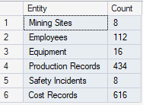
DQL: Validation Check
SELECT 'Mining Sites' AS Entity, COUNT(*) AS Count FROM sites
UNION ALL SELECT 'Employees', COUNT(*) FROM employees
UNION ALL SELECT 'Equipment', COUNT(*) FROM equipment
UNION ALL SELECT 'Production Records', COUNT(*) FROM production
UNION ALL SELECT 'Safety Incidents', COUNT(*) FROM safety_incidents
UNION ALL SELECT 'Cost Records', COUNT(*) FROM operating_costs;

Slide 21
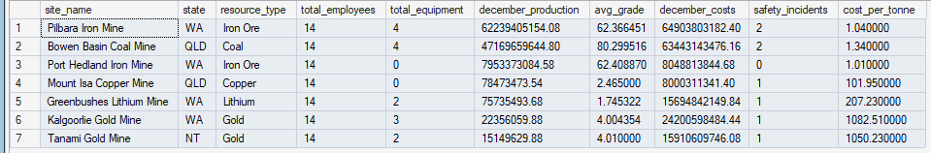
DQL: Site Performance
-- The complex query analysts struggle with
SELECT
s.site_name,
s.state,
s.resource_type,
COUNT(DISTINCT e.employee_id) AS total_employees,
COUNT(DISTINCT eq.equipment_id) AS total_equipment,
SUM(p.tonnes_produced) AS december_production,
AVG(p.grade_percentage) AS avg_grade,
SUM(oc.amount) AS december_costs,
COUNT(DISTINCT si.incident_id) AS safety_incidents,
CASE
WHEN SUM(p.tonnes_produced) > 0
THEN ROUND(SUM(oc.amount) / SUM(p.tonnes_produced), 2)
ELSE 0
END AS cost_per_tonne
FROM sites s
LEFT JOIN employees e ON s.site_id = e.site_id AND e.employment_status = 'Active'
LEFT JOIN equipment eq ON s.site_id = eq.site_id AND eq.operational_status = 'Operational'
LEFT JOIN production p ON s.site_id = p.site_id
AND p.production_date >= '2024-12-01'
AND p.production_date <= '2024-12-31'
LEFT JOIN operating_costs oc ON s.site_id = oc.site_id
AND oc.cost_date >= '2024-12-01'
AND oc.cost_date <= '2024-12-31'
LEFT JOIN safety_incidents si ON s.site_id = si.site_id
AND si.incident_date >= '2024-12-01'
AND si.incident_date <= '2024-12-31'
WHERE s.status = 'Active'
GROUP BY s.site_name, s.state, s.resource_type
ORDER BY december_production DESC;

Slide 22
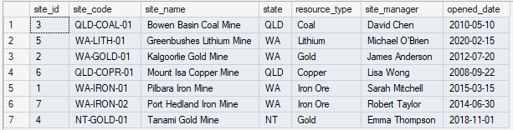
DQL: View for Active Sites
CREATE VIEW vw_ActiveSites
AS
SELECT
site_id,
site_code,
site_name,
state,
resource_type,
site_manager,
opened_date
FROM sites
WHERE status = 'Active';
GO
PRINT '✓ View vw_ActiveSites created';
PRINT '';
PRINT 'Now anyone can query it simply:';
-- Query the view (simple!)
SELECT * FROM vw_ActiveSites ORDER BY site_name;

Slide 23
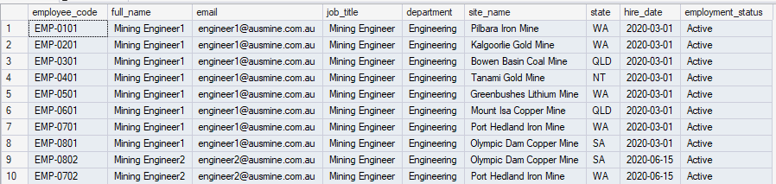
DQL: Security View, hiding salary data
-- Create view that EXCLUDES sensitive salary information
CREATE VIEW vw_EmployeeDirectory
AS
SELECT
employee_code,
first_name + ' ' + last_name AS full_name,
email,
job_title,
department,
s.site_name,
s.state,
hire_date,
employment_status
-- NOTE: annual_salary and superannuation are EXCLUDED
FROM employees e
JOIN sites s ON e.site_id = s.site_id
WHERE e.employment_status = 'Active';
GO
PRINT '✓ View vw_EmployeeDirectory created (without salary data)';
PRINT '';
PRINT 'Junior analysts can now query employee info without seeing salaries:';
SELECT TOP 10 * FROM vw_EmployeeDirectory ORDER BY full_name;

Slide 24
DQL: Complex View for SitePerformanceDashboard
PRINT '--- DEMO 4: Complex View for Executive Dashboard ---';
PRINT '';
GO
-- Create comprehensive site performance view
CREATE VIEW vw_SitePerformanceDashboard
AS
SELECT
s.site_id,
s.site_code,
s.site_name,
s.state,
s.resource_type,
s.site_manager,
-- Employee metrics
COUNT(DISTINCT e.employee_id) AS total_employees,

Slide 25
-- Equipment metrics
COUNT(DISTINCT eq.equipment_id) AS total_equipment,
SUM(CASE WHEN eq.operational_status = 'Operational' THEN 1 ELSE 0 END) AS operational_equipment,
-- Production metrics (December 2024)
SUM(CASE
WHEN p.production_date >= '2024-12-01' AND p.production_date <= '2024-12-31'
THEN p.tonnes_produced ELSE 0
END) AS december_production,
AVG(CASE
WHEN p.production_date >= '2024-12-01' AND p.production_date <= '2024-12-31'
THEN p.grade_percentage ELSE NULL
END) AS avg_grade_december,
-- Cost metrics (December 2024)
SUM(CASE
WHEN oc.cost_date >= '2024-12-01' AND oc.cost_date <= '2024-12-31'
THEN oc.amount ELSE 0
END) AS december_costs,

Slide 26
-- Safety metrics (December 2024)
COUNT(DISTINCT CASE
WHEN si.incident_date >= '2024-12-01' AND si.incident_date <= '2024-12-31'
THEN si.incident_id ELSE NULL
END) AS december_incidents,
-- Calculated KPIs
CASE
WHEN SUM(CASE
WHEN p.production_date >= '2024-12-01' AND p.production_date <= '2024-12-31'
THEN p.tonnes_produced ELSE 0
END) > 0
THEN ROUND(
SUM(CASE
WHEN oc.cost_date >= '2024-12-01' AND oc.cost_date <= '2024-12-31'
THEN oc.amount ELSE 0
END) /
SUM(CASE
WHEN p.production_date >= '2024-12-01' AND p.production_date <= '2024-12-31'
THEN p.tonnes_produced ELSE 0
END), 2)
ELSE 0
END AS cost_per_tonne_december

Slide 27
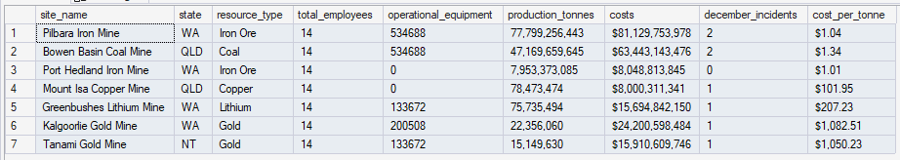
FROM sites s
LEFT JOIN employees e ON s.site_id = e.site_id AND e.employment_status = 'Active'
LEFT JOIN equipment eq ON s.site_id = eq.site_id
LEFT JOIN production p ON s.site_id = p.site_id
LEFT JOIN operating_costs oc ON s.site_id = oc.site_id
LEFT JOIN safety_incidents si ON s.site_id = si.site_id
WHERE s.status = 'Active'
GROUP BY
s.site_id, s.site_code, s.site_name, s.state,
s.resource_type, s.site_manager;
GO
PRINT '✓ View vw_SitePerformanceDashboard created';
PRINT '';
PRINT 'Now executives can get their dashboard with ONE simple query:';
PRINT '';
-- Simple query for executives
SELECT
site_name,
state,
resource_type,
total_employees,
operational_equipment,
FORMAT(december_production, 'N0') AS production_tonnes,
FORMAT(december_costs, 'C0') AS costs,
december_incidents,
FORMAT(cost_per_tonne_december, 'C2') AS cost_per_tonne
FROM vw_SitePerformanceDashboard
ORDER BY december_production DESC;

Slide 28
DQL: Parameterized Queries on Views on Production Analysis
CREATE VIEW vw_ProductionAnalysis
AS
SELECT
s.site_name,
s.state,
s.resource_type,
p.production_date,
p.shift_type,
p.tonnes_produced,
p.grade_percentage,
p.operating_hours,
ROUND(p.tonnes_produced / p.operating_hours, 2) AS tonnes_per_hour
FROM production p
JOIN sites s ON p.site_id = s.site_id;
GO
PRINT '✓ View vw_ProductionAnalysis created';
PRINT '';
PRINT 'Analysts can now filter by any parameter they need:';
PRINT '';

Slide 29
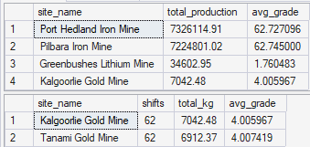
-- Example 1: Filter by state
PRINT '1. Western Australia production only:';
SELECT
site_name,
SUM(tonnes_produced) AS total_production,
AVG(grade_percentage) AS avg_grade
FROM vw_ProductionAnalysis
WHERE state = 'WA'
AND production_date >= '2024-12-01'
GROUP BY site_name
ORDER BY total_production DESC;
PRINT ‘’;
-- Example 2: Filter by resource type
PRINT '2. Gold production analysis:';
SELECT
site_name,
COUNT(*) AS shifts,
SUM(tonnes_produced) AS total_kg,
AVG(grade_percentage) AS avg_grade
FROM vw_ProductionAnalysis
WHERE resource_type = 'Gold'
AND production_date >= '2024-12-01'
GROUP BY site_name;
PRINT '';
GO

Slide 30
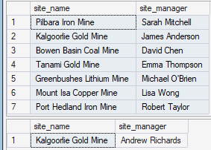
DQL: Updating Data through views on Site Managers
-- Create updatable view
CREATE VIEW vw_SiteManagers
AS
SELECT
site_id,
site_name,
site_manager,
status
FROM sites;
GO
PRINT '✓ View vw_SiteManagers created';
PRINT '';
-- Show current site managers
PRINT 'Current site managers:';
SELECT site_name, site_manager FROM vw_SiteManagers WHERE status = 'Active';
PRINT '';
PRINT 'Updating site manager through view...';
-- Update through view
UPDATE vw_SiteManagers
SET site_manager = 'Andrew Richards'
WHERE site_name = 'Kalgoorlie Gold Mine';
PRINT '✓ Update successful';
PRINT '';
PRINT 'Verify update:';
SELECT site_name, site_manager FROM vw_SiteManagers WHERE site_name = 'Kalgoorlie Gold Mine';
PRINT '';
PRINT 'Note: Simple views (single table, no aggregations) are updatable!';
PRINT '';
GO

Slide 31
DQL: Managing views on Active Sites
-- List all views in database
PRINT 'All views in AusMine_Resources database:';
SELECT
TABLE_NAME AS ViewName,
'View' AS ObjectType
FROM INFORMATION_SCHEMA.VIEWS
ORDER BY TABLE_NAME;
PRINT '';
-- View definition
PRINT 'View definition for vw_ActiveSites:';
EXEC sp_helptext 'vw_ActiveSites';
PRINT '';

Slide 32
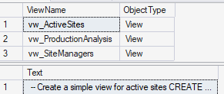
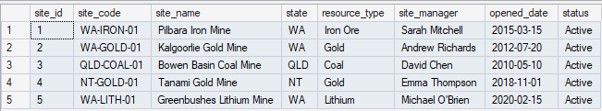
-- Alter a view
PRINT 'Modifying vw_ActiveSites to include status...';
GO
ALTER VIEW vw_ActiveSites
AS
SELECT
site_id,
site_code,
site_name,
state,
resource_type,
site_manager,
opened_date,
status -- Added this column
FROM sites
WHERE status IN ('Active', 'Maintenance'); -- Modified filter
GO
PRINT '✓ View altered successfully';
SELECT TOP 5 * FROM vw_ActiveSites;
PRINT '';
GO

Slide 33
DQL: Data Quality Views and Validation
-- Create view to identify data quality issues
CREATE VIEW vw_DataQualityAlerts
AS
SELECT
'Missing Site Manager' AS alert_type,
site_name AS affected_entity,
'Site: ' + site_name + ' has no assigned manager' AS alert_message,
'High' AS priority
FROM sites
WHERE site_manager IS NULL AND status = 'Active'
UNION ALL
SELECT
'Equipment Overdue Maintenance',
s.site_name,
'Equipment ' + eq.equipment_code + ' last maintained ' +
CAST(DATEDIFF(DAY, eq.last_maintenance_date, GETDATE()) AS NVARCHAR) + ' days ago',
CASE
WHEN DATEDIFF(DAY, eq.last_maintenance_date, GETDATE()) > 60 THEN 'Critical'
WHEN DATEDIFF(DAY, eq.last_maintenance_date, GETDATE()) > 45 THEN 'High'
ELSE 'Medium'
END
FROM equipment eq
JOIN sites s ON eq.site_id = s.site_id
WHERE eq.last_maintenance_date < DATEADD(DAY, -30, GETDATE())

Slide 34
AND eq.operational_status = 'Operational'
UNION ALL
SELECT
'Unresolved Safety Incident',
s.site_name,
'Incident #' + CAST(si.incident_id AS NVARCHAR) + ' (' + si.severity + ') from ' +
CONVERT(NVARCHAR(20), si.incident_date, 120) + ' still unresolved',
CASE si.severity
WHEN 'Critical' THEN 'Critical'
WHEN 'Serious' THEN 'High'
ELSE 'Medium'
END
FROM safety_incidents si
JOIN sites s ON si.site_id = s.site_id
WHERE si.resolved = 0;
GO

Slide 35
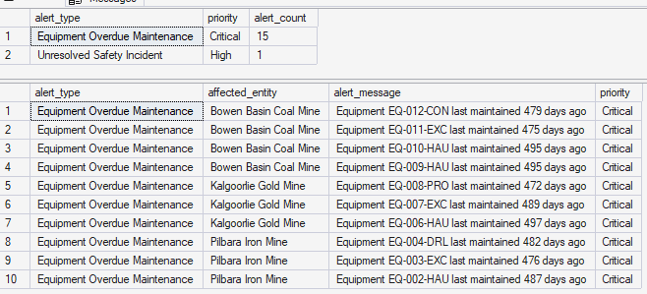
PRINT '✓ View vw_DataQualityAlerts created';
PRINT '';
PRINT 'Data quality dashboard:';
SELECT
alert_type,
priority,
COUNT(*) AS alert_count
FROM vw_DataQualityAlerts
GROUP BY alert_type, priority
ORDER BY
CASE priority
WHEN 'Critical' THEN 1
WHEN 'High' THEN 2
WHEN 'Medium' THEN 3
ELSE 4
END;
PRINT '';
PRINT 'Detailed alerts:';
SELECT TOP 10 * FROM vw_DataQualityAlerts ORDER BY
CASE priority
WHEN 'Critical' THEN 1
WHEN 'High' THEN 2
ELSE 3
END;
PRINT '';
GO

Slide 36
DQL: Indexed Views for Performance
-- Create view with aggregations suitable for indexing
CREATE VIEW vw_DailyProductionSummary
WITH SCHEMABINDING -- Required for indexed views
AS
SELECT
p.site_id,
p.production_date,
p.resource_type,
COUNT_BIG(*) AS shift_count, -- COUNT_BIG required for indexed views
SUM(p.tonnes_produced) AS total_tonnes,
SUM(p.operating_hours) AS total_hours
FROM dbo.production p -- Must use schema prefix with SCHEMABINDING
GROUP BY p.site_id, p.production_date, p.resource_type;
GO
-- Create unique clustered index on the view
CREATE UNIQUE CLUSTERED INDEX IX_DailyProdSummary
ON vw_DailyProductionSummary(site_id, production_date, resource_type);
GO

Slide 37
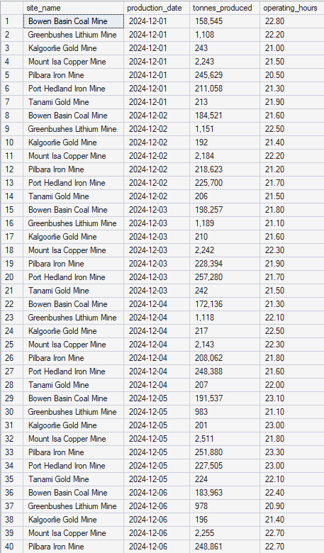
-- Query the indexed view
SELECT
s.site_name,
vw.production_date,
FORMAT(vw.total_tonnes, 'N0') AS tonnes_produced,
vw.total_hours AS operating_hours
FROM vw_DailyProductionSummary vw
JOIN sites s ON vw.site_id = s.site_id
WHERE vw.production_date >= '2024-12-01'
AND vw.production_date <= '2024-12-07'
ORDER BY vw.production_date, s.site_name;
First 40 rows for indexed view

Slide 38
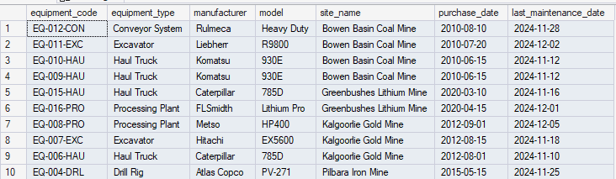
DQL: Simple View for Operational Equipment
CREATE VIEW vw_OperationalEquipment
AS
SELECT
equipment_code,
equipment_type,
manufacturer,
model,
s.site_name,
purchase_date,
last_maintenance_date
FROM equipment e
JOIN sites s ON e.site_id = s.site_id
WHERE e.operational_status = 'Operational';
GO
PRINT '✓ View created';
SELECT TOP 10 * FROM vw_OperationalEquipment ORDER BY site_name;
PRINT '';
GO

Slide 39
DQL: Create Security View for CostSummary
CREATE VIEW vw_CostSummary
AS
SELECT
s.site_name,
s.state,
oc.cost_date,
oc.cost_category,
-- Hide exact amounts, only show ranges
CASE
WHEN oc.amount < 50000 THEN 'Low (<$50k)'
WHEN oc.amount < 150000 THEN 'Medium ($50k-$150k)'
ELSE 'High (>$150k)'
END AS cost_range,
oc.description
FROM operating_costs oc
JOIN sites s ON oc.site_id = s.site_id;
GO
PRINT '✓ View created (with masked amounts)';
SELECT TOP 10 * FROM vw_CostSummary ORDER BY cost_date DESC;
PRINT '';
GO

Slide 40
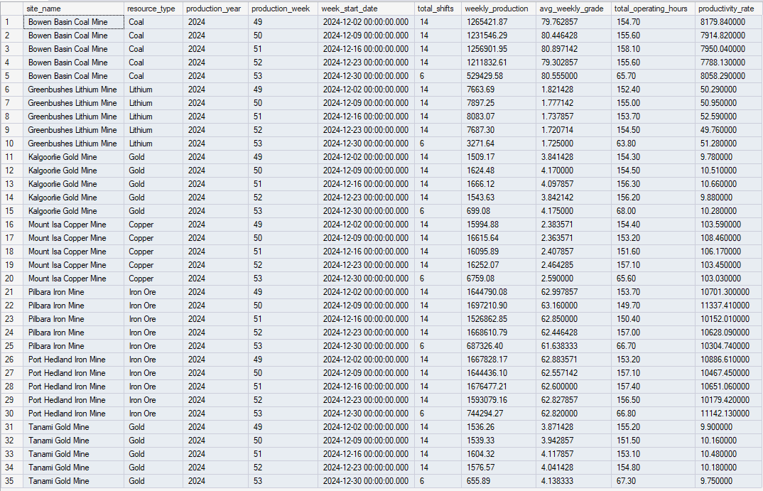
DQL: Create Analytical Weekly Production Trends View
CREATE VIEW vw_WeeklyProductionTrends
AS
SELECT
s.site_name,
s.resource_type,
DATEPART(YEAR, p.production_date) AS production_year,
DATEPART(WEEK, p.production_date) AS production_week,
DATEADD(WEEK, DATEDIFF(WEEK, 0, p.production_date), 0) AS week_start_date,
COUNT(*) AS total_shifts,
SUM(p.tonnes_produced) AS weekly_production,
AVG(p.grade_percentage) AS avg_weekly_grade,
SUM(p.operating_hours) AS total_operating_hours,
ROUND(SUM(p.tonnes_produced) / SUM(p.operating_hours), 2) AS productivity_rate
FROM production p
JOIN sites s ON p.site_id = s.site_id
GROUP BY
s.site_name,
s.resource_type,
DATEPART(YEAR, p.production_date),
DATEPART(WEEK, p.production_date),
DATEADD(WEEK, DATEDIFF(WEEK, 0, p.production_date), 0);
GO

Slide 41
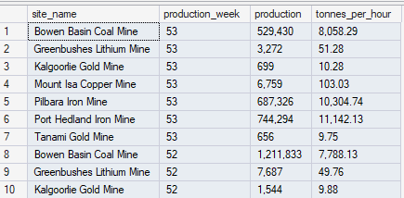
PRINT '✓ View created';
SELECT TOP 10
site_name,
production_week,
FORMAT(weekly_production, 'N0') AS production,
FORMAT(productivity_rate, 'N2') AS tonnes_per_hour
FROM vw_WeeklyProductionTrends
ORDER BY production_year DESC, production_week DESC;
PRINT '';
GO

Slide 42
DQL: Create Dashboard for Executive Dashboard
CREATE VIEW vw_ExecutiveDashboard
AS
SELECT
s.site_name,
s.state,
s.resource_type,
s.site_manager,
-- Workforce
(SELECT COUNT(*) FROM employees e
WHERE e.site_id = s.site_id AND e.employment_status = 'Active') AS active_employees,
-- Equipment
(SELECT COUNT(*) FROM equipment eq
WHERE eq.site_id = s.site_id AND eq.operational_status = 'Operational') AS operational_equipment,
-- December Production
(SELECT SUM(tonnes_produced) FROM production p
WHERE p.site_id = s.site_id
AND p.production_date >= '2024-12-01'
AND p.production_date <= '2024-12-31') AS dec_production,

Slide 43
-- December Costs
(SELECT SUM(amount) FROM operating_costs oc
WHERE oc.site_id = s.site_id
AND oc.cost_date >= '2024-12-01'
AND oc.cost_date <= '2024-12-31') AS dec_costs,
-- Safety Score (incidents)
(SELECT COUNT(*) FROM safety_incidents si
WHERE si.site_id = s.site_id
AND si.incident_date >= '2024-12-01'
AND si.incident_date <= '2024-12-31') AS dec_incidents,
-- Performance Rating
CASE
WHEN (SELECT COUNT(*) FROM safety_incidents si
WHERE si.site_id = s.site_id
AND si.incident_date >= '2024-12-01'
AND si.severity IN ('Serious', 'Critical')) > 0 THEN 'Needs Attention'
WHEN (SELECT SUM(tonnes_produced) FROM production p
WHERE p.site_id = s.site_id
AND p.production_date >= '2024-12-01') > 1000000 THEN 'Excellent'
WHEN (SELECT SUM(tonnes_produced) FROM production p
WHERE p.site_id = s.site_id
AND p.production_date >= '2024-12-01') > 500000 THEN 'Good'
ELSE 'Average'
END AS performance_rating

Slide 44
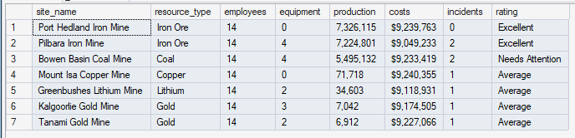
FROM sites s
WHERE s.status = 'Active';
GO
PRINT '✓ Executive dashboard view created';
PRINT '';
SELECT
site_name,
resource_type,
active_employees AS employees,
operational_equipment AS equipment,
FORMAT(dec_production, 'N0') AS production,
FORMAT(dec_costs, 'C0') AS costs,
dec_incidents AS incidents,
performance_rating AS rating
FROM vw_ExecutiveDashboard
ORDER BY dec_production DESC;
PRINT '';
GO

